Slide 1
HTML 5 & CSS

Slide 2
HTML 5
Hypertext
Markup ( Content)
Language

Slide 3








Code Editors ( VS, Sublime, Atom)

Slide 4
HTML File
File Extension : .html or .htm
<!doctype html> = > tell the browser that this is some kind of html file and html 5 latest version.
Two parts
<head></head>
<body> </body>

Slide 5
<head></head>
<title></title>
<meta charset=“utf-8”>

Slide 6

Technologies that drive Web
Structure
Style
Actions or Behaviors

Slide 7
HTML Tag : Element
<opening tag>
…….<content>……..
<closing tag>
Example Element => p, div

Slide 8
HTML Tag: Attributes
<p title=“This is some web site’s content”>
Hello World
</p>

Slide 9
Document Object Model
html
<!DOCTYPE html>
<html>
<head>
<title>My First Web Page</title>
</head>
<body>
Hello from our page!
</body>
</html>
head
body
title
Hello from our page!
My First Web Page

Slide 10
How to render Headings
<h1>………………..</h1> Biggest
<h2>………………..</h2>
<h3>………………..</h3>
<h4>………………..</h4>
<h5>………………..</h5>
<h6>………………..</h4> Smallest

Slide 11
Paragraph
<p> …….. </p>

Slide 12
How to create titles and text
<h1> Latest Posts </h1>
<h2> These all are the latest posts</h2>
<section>
<h3> About Semantic Elements</h3>
<p> Here is about semantic elements in HTML 5</p>
<h5> Author: Nay Win</h5>
</section>

Slide 13
Applying text formatting
<b>
<i>
<sup>
<sub>

Slide 14
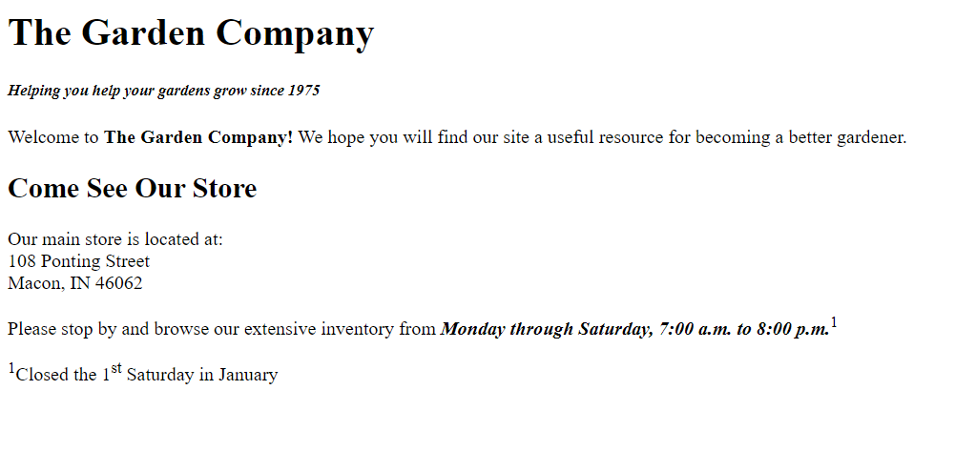
Challenge 1

Slide 15
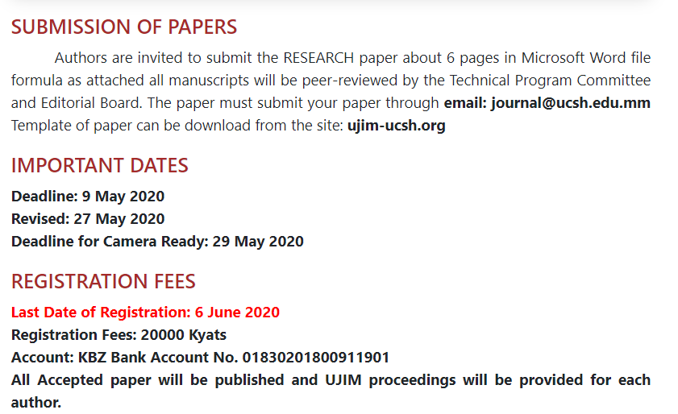
Challenge 2

Slide 16
Lists
Unordered List
<ul> <li>……</li></ul>
Ordered List
<ol><li>…….</li></ol>

Slide 17
List Style Type
Unordered List
Disc (the default)
Circle
Square
<ul style=“list-style-type:square”>
Ordered List
Decimal (the default)
Decimal-leading-zero
Lower-roman
Upper-roman
Lower-alpha
Upper-alpha
none

Slide 18
Definition List
<dl> : a list that presents terms with their definitions
<dt> :definition term
<dd> :definition description

Slide 19
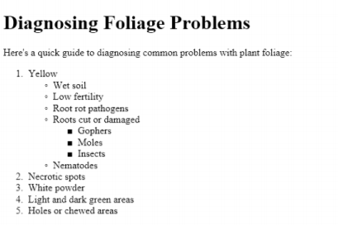
Challenge 2

Slide 20
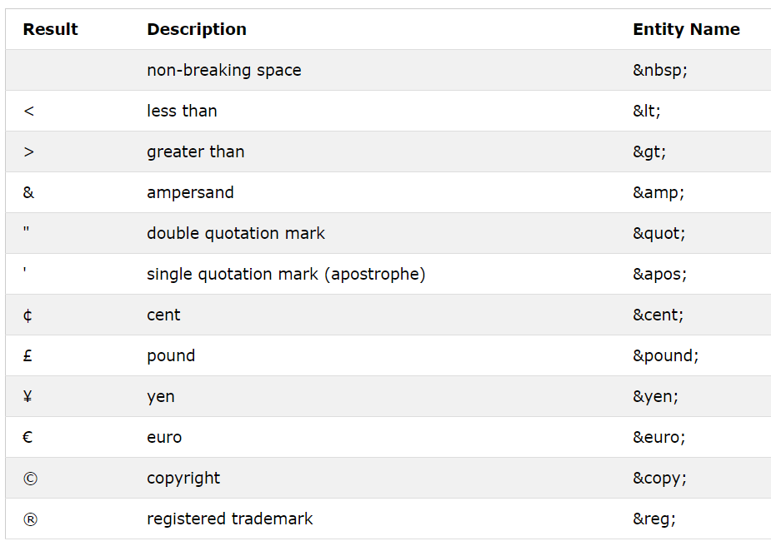
Character Entity References

Slide 21
Creating a horizontal line
<hr>

Slide 22
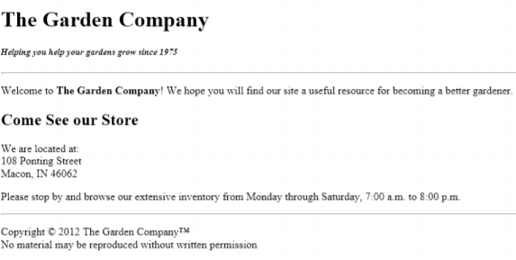
Challenge 2

Slide 23
Creating Links
<a href=“challenge1.html”> Search in Google! </a>
<a href=“www.google.com”> Search in Google! </a>
<a href=“#section1”>Section 1 </a>
<section id=“section1”>
………
</section>
Internal link to other pages
External link to other web sites
Hyperlink to other content

Slide 24
Creating Links with target window
<a href="foliage.html" target="_blank">Diagnosing Foliage Problems</a>

Slide 25
Creating link to email address
<a href="mailto:support@adatum.com">Contact Us</a>
Title</a>
<a href="https://mail.google.com/mail/?view=cm&fs=1&tf=1&to=hostmyanmarmandalay@gmail.com" target="_blank">

Slide 26
Creating link to other content
<li><a href="spray.doc">Microsoft Word version</a></li>

Slide 27
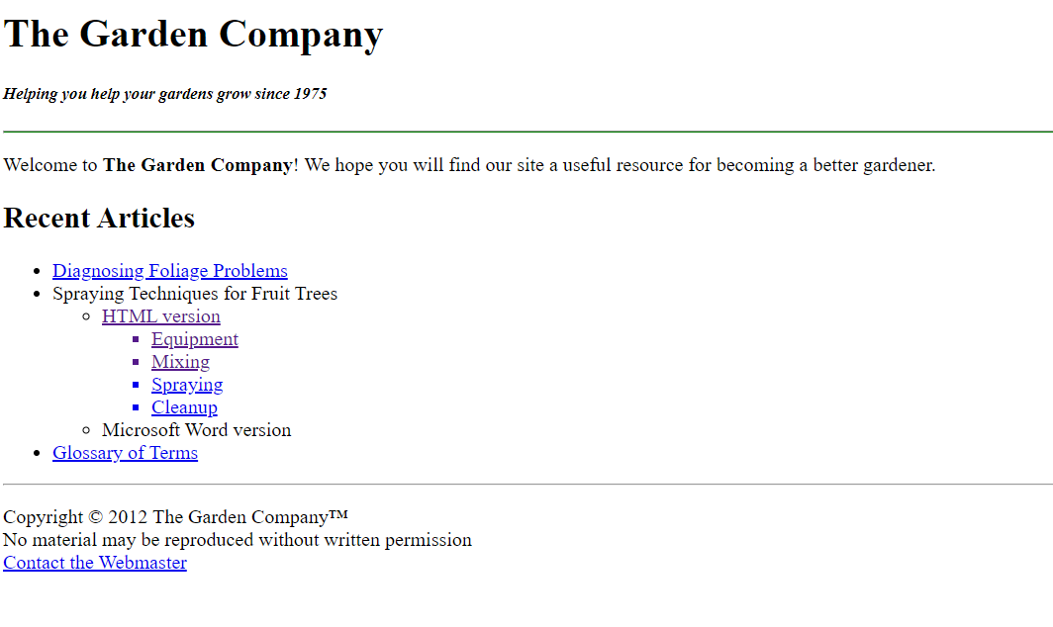
Challenge

Slide 28
Image
<img src="../images/github.jpg" width="200px"/>
src : file path
Width
Height
Alt : alternate text

Slide 29
3 types of image src
1. html and jpg are in the same directory.
src="github.jpg"
2. jpg is placed in another folder.
src="images/github.jpg"
3. html is placed in other folder. (different folders) ****
src="../images/github.jpg"

Slide 30
Table
<table>
<tr>
<th> </th>
<th></th>
</tr>
<tr>
<td> </td>
<td></td>
</tr>
</table>
Table row
Table row

Slide 31
thead
<thead>
<tr>
<th>Month</th>
<th>Savings</th>
</tr>
</thead>

Slide 32
tbody
<tbody>
<tr>
<td>January</td>
<td>$100</td>
</tr>
<tr>
<td>February</td>
<td>$80</td>
</tr>
</tbody>

Slide 33
tfoot
<tfoot>
<tr>
<td>Sum</td>
<td>$180</td>
</tr>
</tfoot>

Slide 34
Example
Month | Income | Bonus
January | $100 | 10
February | &120 | 13
Month | Income | Bonus

Slide 35
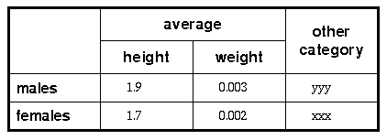
Challenge 4
Notes:
<caption>A more complex table</caption> <tr><th rowspan=2><th colspan=2>average<th rowspan=2>other<br>category <tr><th>height<th>weight <tr><th align=left>males<td>1.9<td>0.003<td>yyy <tr><th align=left>females<td>1.7<td>0.002<td>xxx

Slide 36
Div

Slide 37
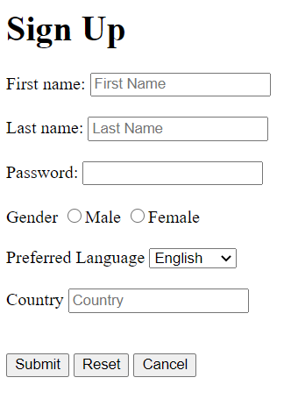
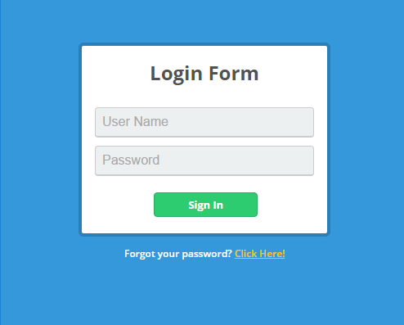
Form

Slide 38
Form tag
<form>
</form>
Action:”#” or “loginsuccess.html”
Method : post/get

Slide 39
Text field
<input type=“text” name=“name” placeholder=“Write your name”>
Type=“text”
name=“yourname”

Slide 40
Password
<input type=“password” name=“pwd” placeholder=“Password”>
Type=“password”
Name=“yourname”

Slide 41
Radio Button
<input type=“radio” name=“gender” value=“Male”>
<input type=“radio” name=“gender” value=“Female” checked>
Type=“radio”
name=“yourname”
*** Name must be the same for radio button group.

Slide 42
Dropdown list
<select name=“course”>
<option value=“IT”>IT</option>
<option value=“civil”>Civil Engineering</option>
</select>

Slide 43
Datalist
<input name="country" list="countries" placeholder="Country">
<datalist id="countries">
<option value="Afghatannistan">Afghanistan
<option value="Bhutan">Bhutan
<option value="Burma"> Burma
</datalist>

Slide 44
Calendar
<input type="date" name="bdate" required/>

Slide 45
Checkbox
<input type="checkbox" name=“Sports" value=“badminton" checked> Badminton

Slide 46
Textarea
<textarea cols="25" rows="7"></textarea>

Slide 47
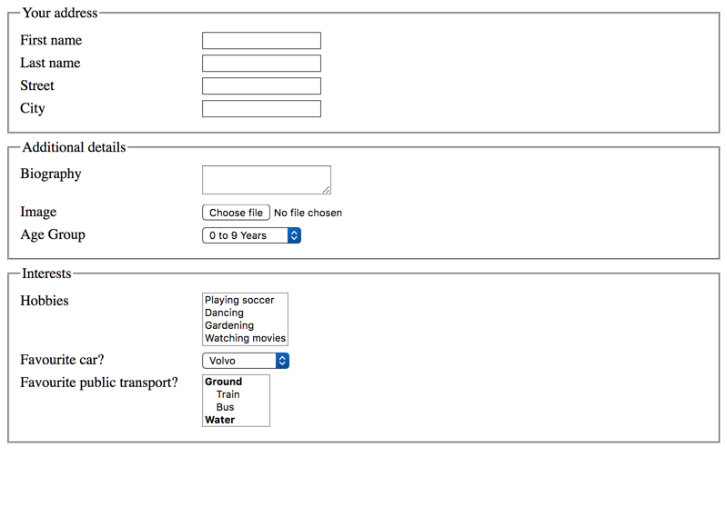
Fieldset
Fieldset : used to group related elements in form
Legend: a caption for fieldset

Slide 48
<iframe>
<iframe width="420" height="315" src="https://www.youtube.com/embed/tgbNymZ7vqY?playlist=tgbNymZ7vqY&loop=1"> </iframe>

Slide 49
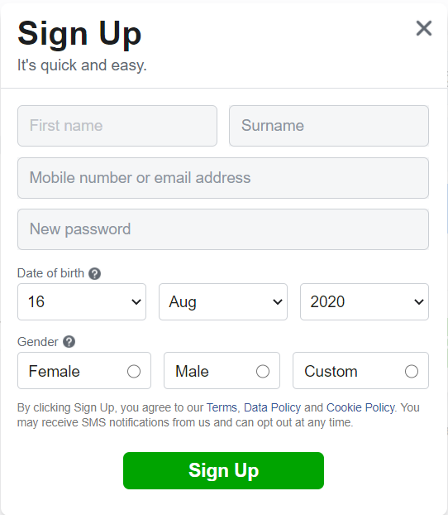
Challenge

Slide 50
Which Meta Tags are required for web page?
<meta charset=“utf-8”>
<meta name=“description” content=“ This is a website for HTML and CSS”>
<meta name=“viewport” content=“width:device-width,initial-scale=1”>
<meta name=“keywords” content=“coding,tutorial,html,css”>
<meta name=“author” content=“Host Myanmar(Mandalay)”>

Slide 51
Better HTML
Always declare document type
Use lower case element names
Use lowercase attribute names
Use alt, width, height for image
Use title element

Slide 52
HTML 4 Organization
<div class="header">
<div class="nav">
<div class="section">
<div class="footer"

Slide 53
HTML 5 Organization
<header>
<hgroup>
<nav>
<section>
<footer>
<address>
<aside>
<audio>
<video>
<datalist>

Slide 54
Video
<video width="320" height="240" autoplay> <source src="movie.mp4" type="video/mp4"> <source src="movie.ogg" type="video/ogg"> Your browser does not support the video tag. </video>

Slide 55
CSS : Cascading Style Sheet
Used to interact with style of HTML
To design web page better
3 types of style structure
Inline
Internal
External

Slide 56
CSS: Inline Style
<h1 style=“color:rgb(173,68,90);text-align=“center”></h1>
For colors, use color picker

Slide 57
CSS:Internal Style
<style>
h1{
color: red;
text-align: center;
}
</style>

Slide 58
External Style
<head>
<link rel="stylesheet" href="styles.css">
</head>
style.css
h1{
color: red;
Text-align: center;
}

Slide 59
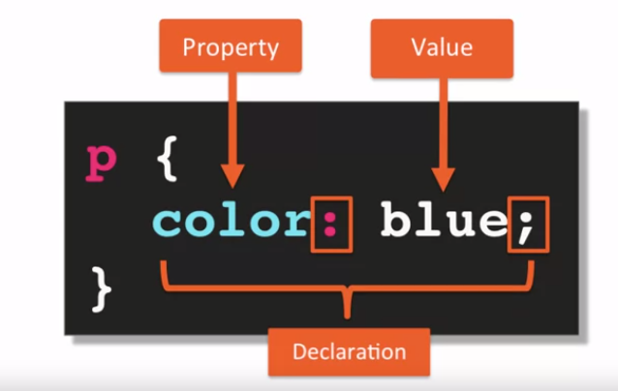
CSS Structure
Selector

Slide 60
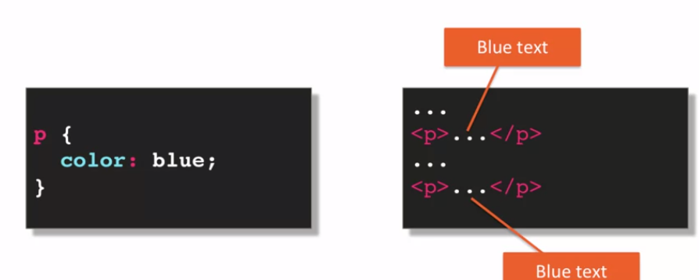
Element Selectors

Slide 61
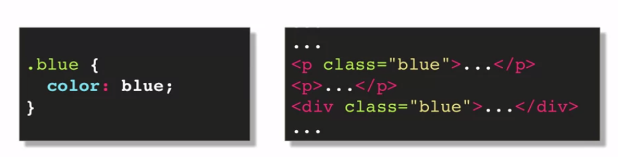
Class Selector

Slide 62
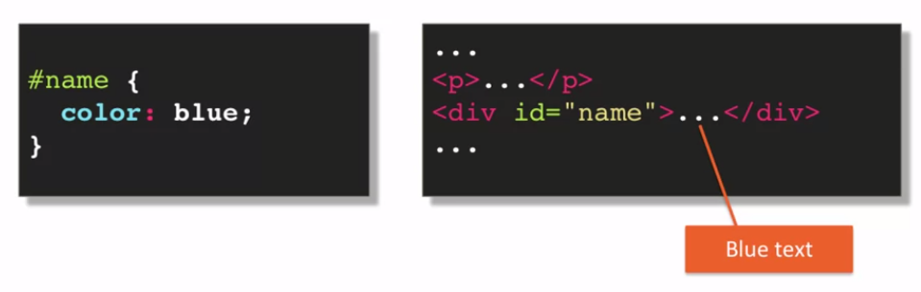
ID Selector

Slide 63
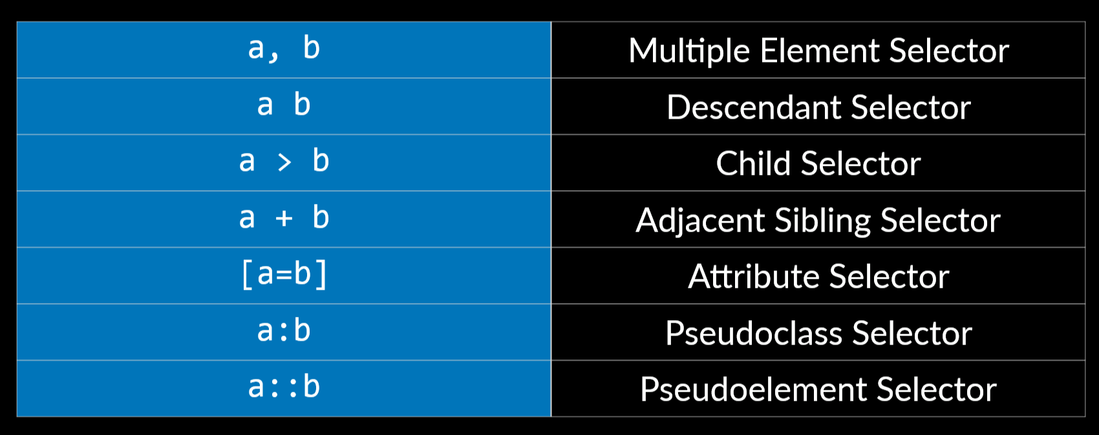
CSS for Element Selectors

Slide 64
Multiple Element Selector Creating styles for multiple tags
<style>
h1, h2, h3, h4, h5, h6
{ color: red }
</style>

Slide 65
Descendent Selector Creating styles for nested levels
ol ul
{list-style-type: circle}

Slide 66
Child Selector Immediate elements
ol > li { color: red; }

Slide 67
Pseudoclass Selector Styling links
<style>
a:link {color: black}
a:visited {color: magenta}
</style>
Other pseudoclasses:
Focus
Hover
active

Slide 68
CSS for text style
Font-family
Font-size
Font-weight
Color
Text-align
Text-decoration
Text-indent
Text-transform
h1 { text-decoration: underline overline dotted red;
}
div{
text-indent: 50px/-2em/30%;
text-transform: uppercase/lowercase/capitalize;
}

Slide 69
Spacing between letters
<p style="letter-spacing: 4px">This text has increased letter spacing.</p>

Slide 70
CSS:Conflict Resolution
Origin
Merge
Precedence
Specifity

Slide 71
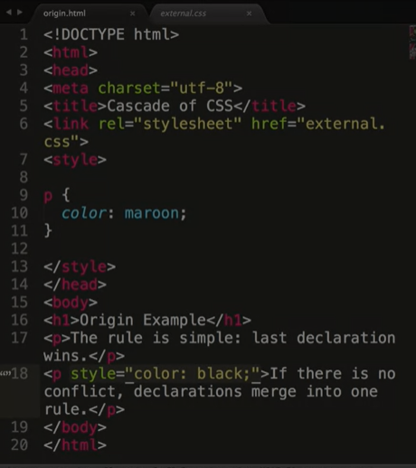
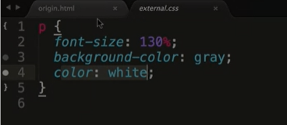
CSS: Origin
No conflict
Declaration Merge
In Conflict
*** apply last declaration

Slide 72
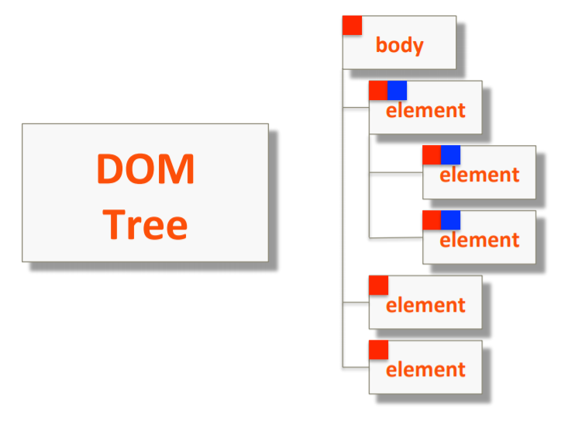
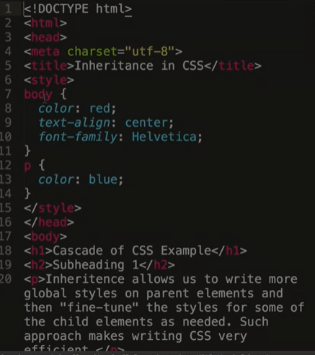
CSS: Inheritance

Slide 73
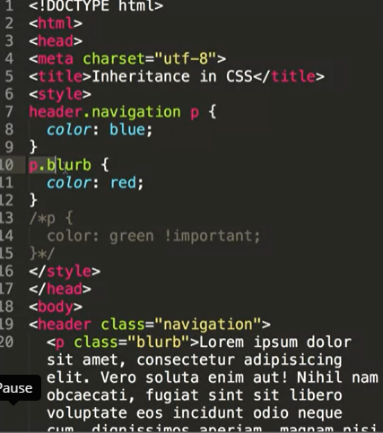
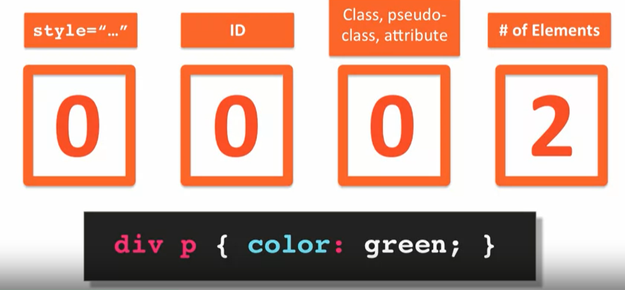
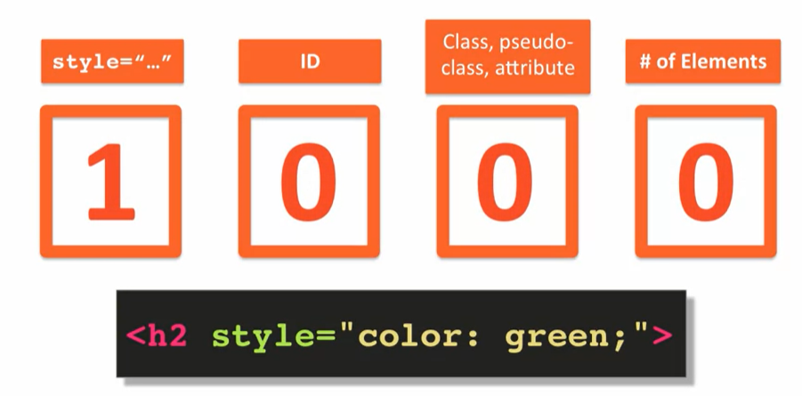
CSS: Specifity

Slide 74
CSS for Background Color
background-color: coral;

Slide 75
CSS for Background Image
<body style="background-image: url(granite.gif)">
Default: repeated vertically and horizontally
No repeat:
body {
background-image: url("img_tree.png");
background-repeat: no-repeat; repeat-y or repeat-x;
}

Slide 76
CSS for fonts
without importing fonts
font-family: arial;
with font imported through link
font-family: 'Lobster’;
<link href="https://fonts.googleapis.com/css2?family=Antic+Slab&display=swap" rel="stylesheet">
With font imported by uploading the font into root folder
@font-face {
font-family: Lobster;
src: url(fonts/Lobster-Regular.ttf);
}

Slide 77
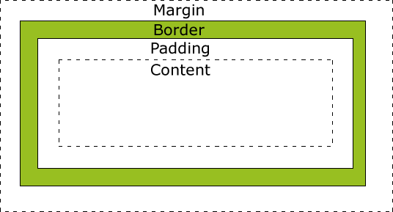
Margin & padding

Slide 78
CSS for paragraphs
First line indent
p {text-indent: 20px}
Padding
p {padding: 20px}
Margin
p {margin: 20px}

Slide 79
Setting border to a paragraph
<p style="border-style: solid">
p {border-style: solid; padding: 15px}
p {border-style: solid; border-width: 2px; border-color: blue}
<p style="border: 2px green solid">

Slide 80
Border styles
Solid
Doted
Dashed
Double
Groove
Ridge
Inset
Outset
none

Slide 81
Navigation Bar

Slide 82
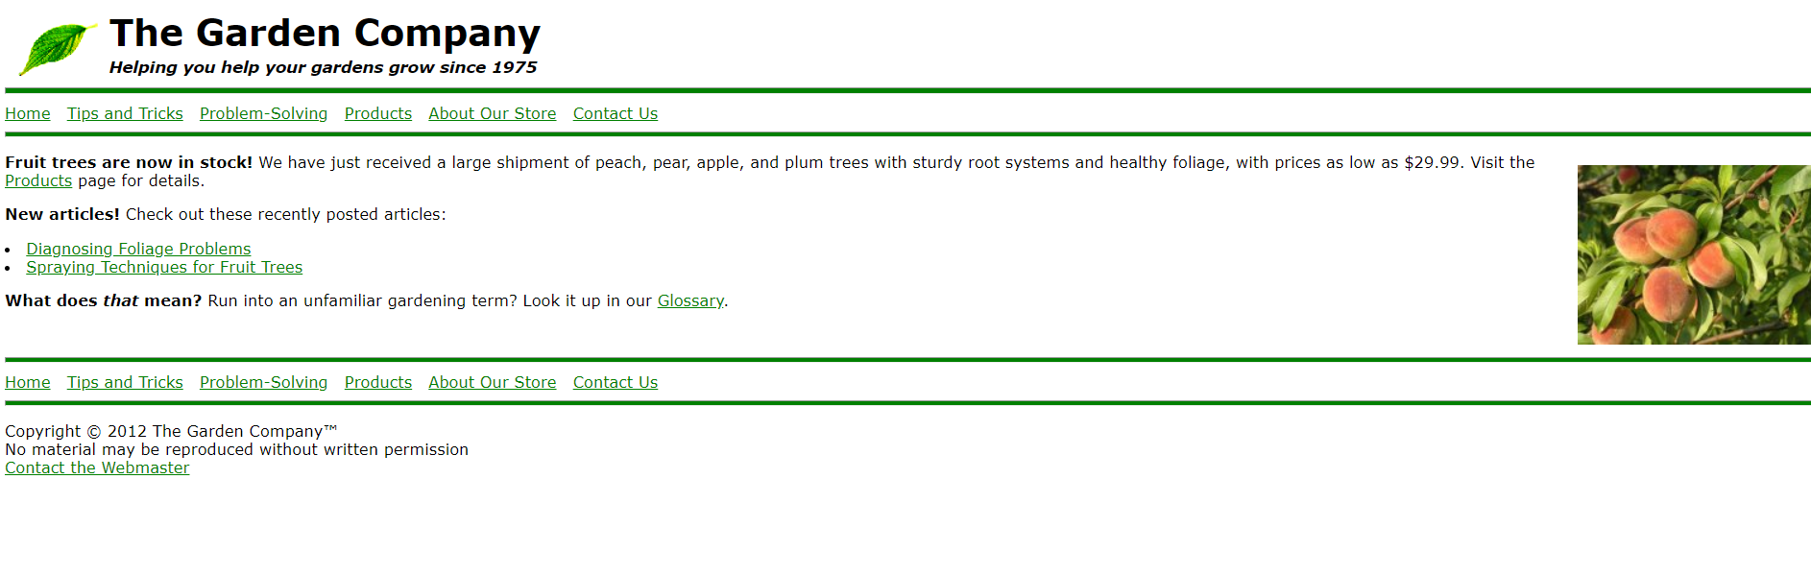
How to create menu

Slide 83
Displaying Images
<img src=“cat.jpg”>
<img src=“cat.jpg” width=“200” height=“300” alt=“my cat”>
<img src=“cat.jpg” width=“50%” alt=“my cat”>
*** Tag image keywords using “alt” for SEO

Slide 84
Image surrounding text around image
Float:left or right
<img src="logo.gif" style="float: left">

Slide 85
Arranging elements
<h2 style="clear: left">Recent Articles</h2>

Slide 86
Hyperlinking from graphics
<a href="http://www.contoso.com" title="Home page"> <img src="images/leaf.gif" style="float: left; margin: 5px; border: none"> </a>

Slide 87
Common Semantic Elements in HTML 5
<header>
<footer>
<section>
<nav>
<article>
<hgroup>
*** Non semantic elements : <div>, <span> and so on…

Slide 88
Positioning a division to the right or left using float
Float
take an element out of normal flow and put content side-by-side.
Elements are floated horizontally
Float:left or right;
<div style="width: 150px; float: left">
Clear
To cancel float property
Clear:left or right or both;

Slide 89
Positioning a division on the page
position:absolute
The element is removed from the normal document flow,
no space is created for the element in the page layout
positon:relative
The element is positioned according to the normal flow of the document, and then offset relative to itself based on the values of top, right, bottom, and left.
The offset does not affect the position of any other elements
Position:fixed

Slide 90
Position
position:fixed or relative or absolute;
bottom:0px;
right:0px;

Slide 91
Flex
Display: flex
Flex-wrap: wrap;

Slide 92
Transparency
Using RGBA
background: rgba(76, 175, 80, 0.3)
Using opacity
Opacity: 0.0…..1.0;

Slide 93
Overlap : z-index
determines the stack level of an HTML element.
the element will be closer to the top of the stacking order
Z-index: 1,2,3, or….. 500,999;
***z-index works on the element whose position is absolute, relative and fixe;

Slide 94
Grid
Display : grid | inline-grid
Gird for block level elements
Inline-grid for inline level elements
grid-template-columns and grid-template-rows
the columns and rows of the grid with a space-separated list of values.

Slide 95
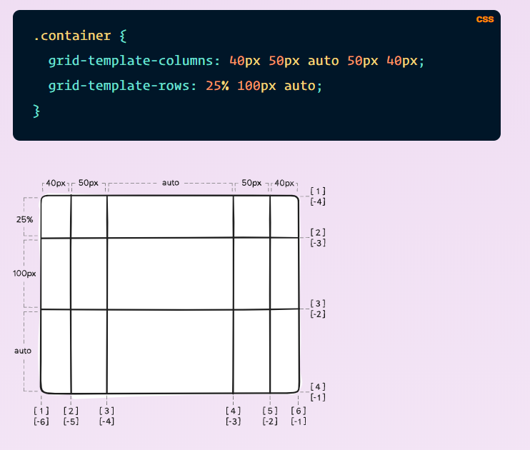
Grid

Slide 96
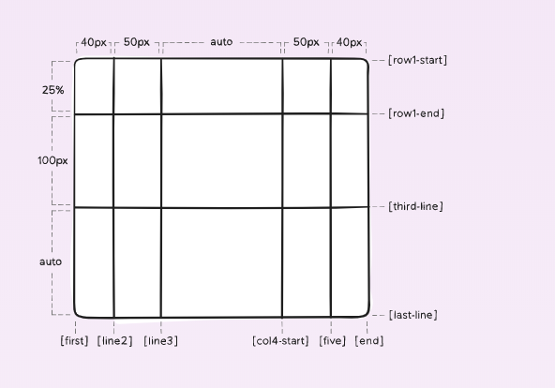
.container
{
grid-template-columns: [first] 40px [line2] 50px [line3] auto [col4-start] 50px [five] 40px [end];
grid-template-rows: [row1-start] 25% [row1-end] 100px [third-line] auto [last-line];
}

Slide 97
Responsive Design
the idea that a website should look good regardless of the platform its viewed from
Site designed to adapt its layout to the viewing environment
Using fluid
Grids
Media queries
Flexible images

Slide 98
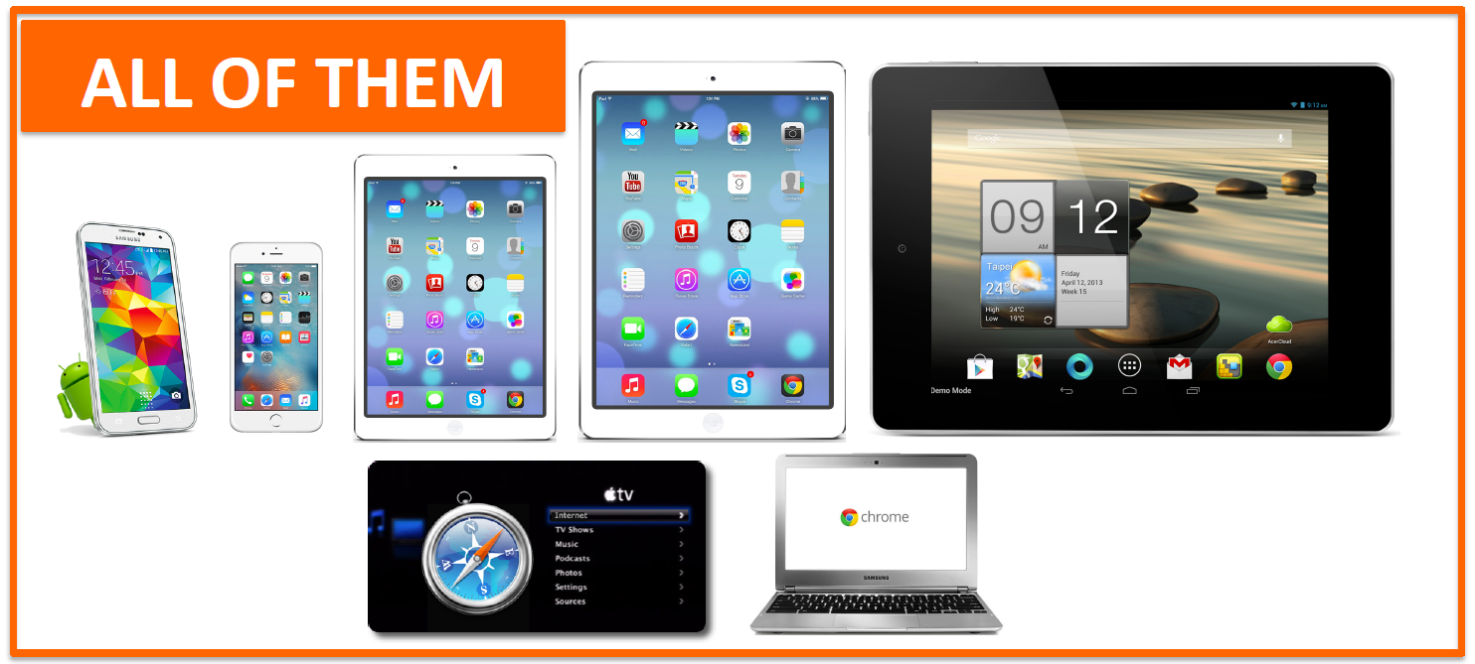
Responsive Design

Slide 99
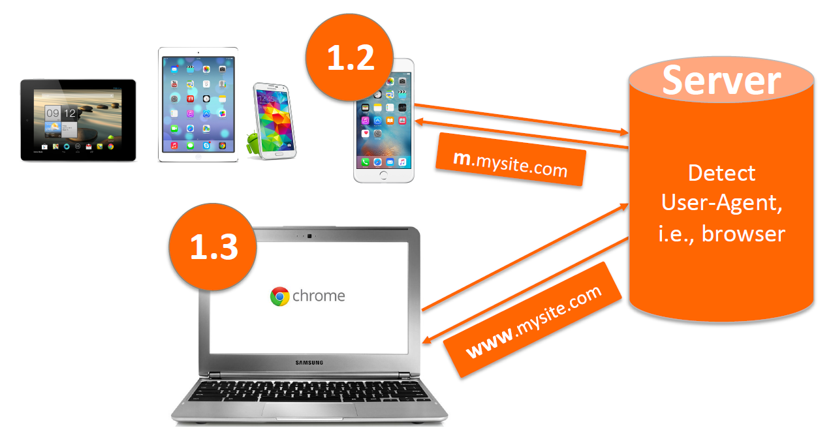
Responsive Design

Slide 100
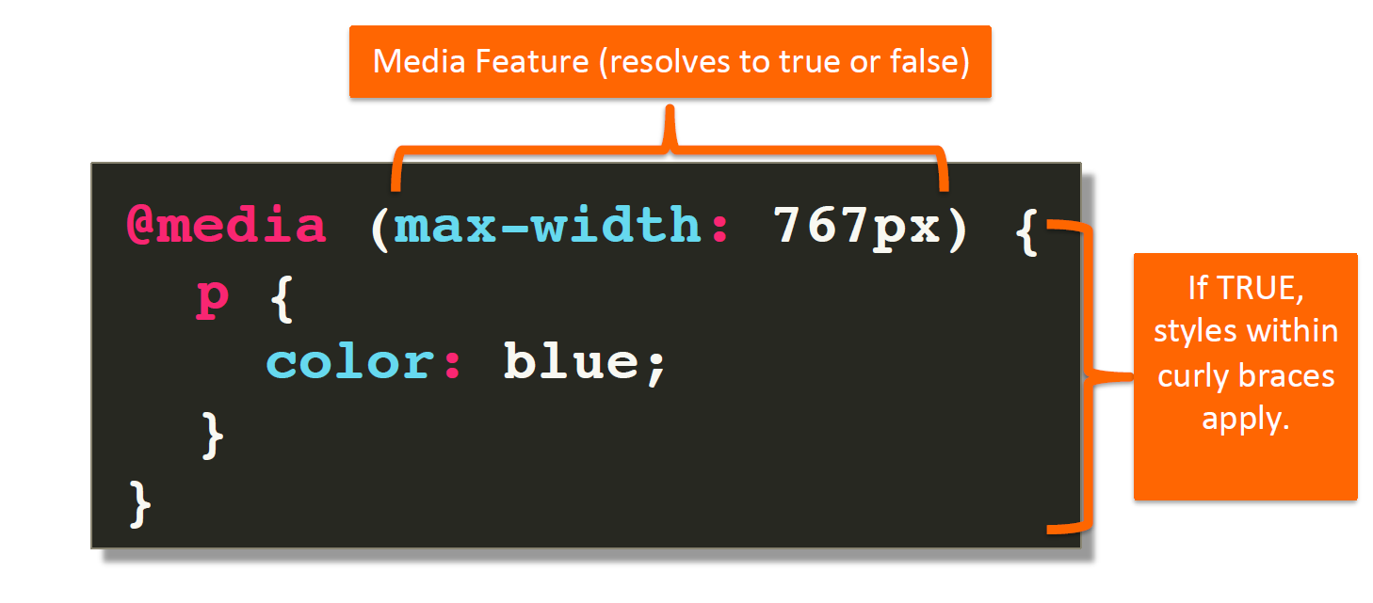
Media Query

Slide 101
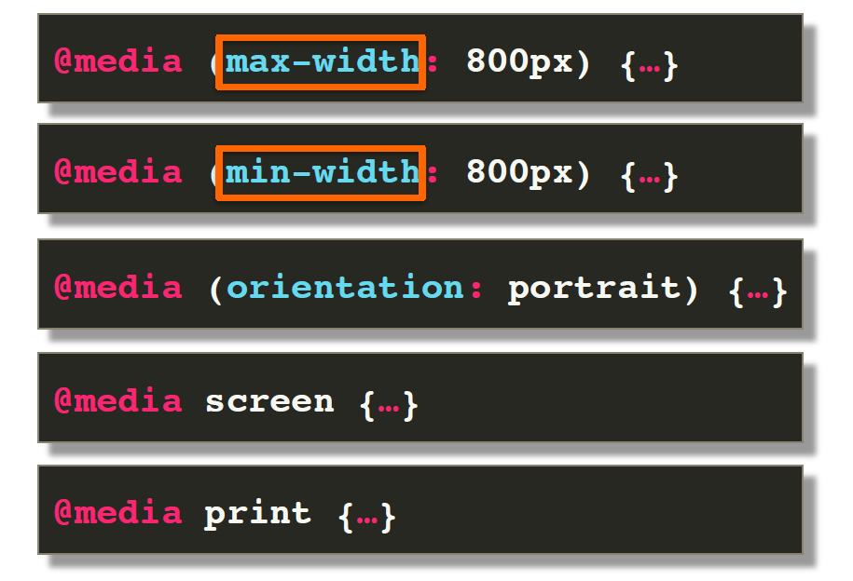
Media Query Common Features

Slide 102

Media Query
@media
Screen
/* Extra small devices (phones, 600px and down) */ @media only screen and (max-width: 600px) {...} /* Small devices (portrait tablets and large phones, 600px and up) */ @media only screen and (min-width: 600px) {...} /* Medium devices (landscape tablets, 768px and up) */ @media only screen and (min-width: 768px) {...} /* Large devices (laptops/desktops, 992px and up) */ @media only screen and (min-width: 992px) {...} /* Extra large devices (large laptops and desktops, 1200px and up) */ @media only screen and (min-width: 1200px) {...}

Slide 103
Media Query
@media
Print
@media print {
.screen-only {
display: none;
}
}

Slide 104
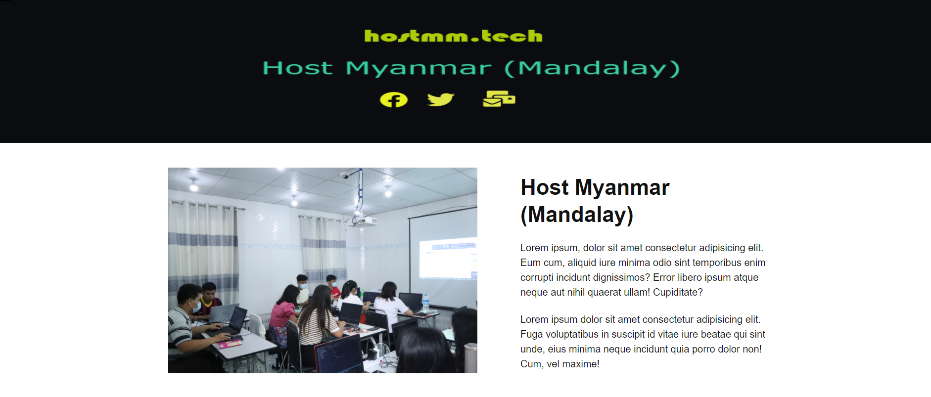

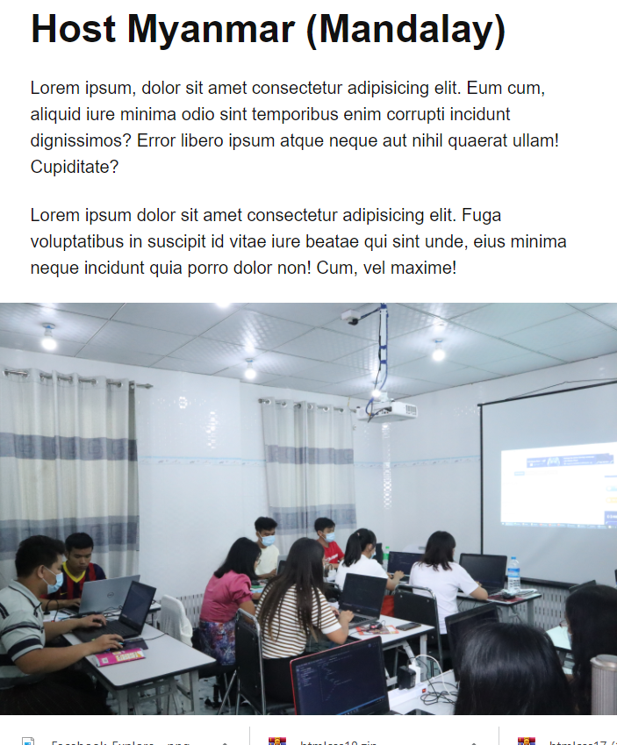
1000px
768px
600px

